Slide 1
6: Creating a Multi-Sensory room
6A: Introduction to Multi-Sensory Rooms including advantages and disadvantages
www.multisensorylearning.lgfl.net ©2018 www.hirstwood.com & London Grid for Learning

Slide 2
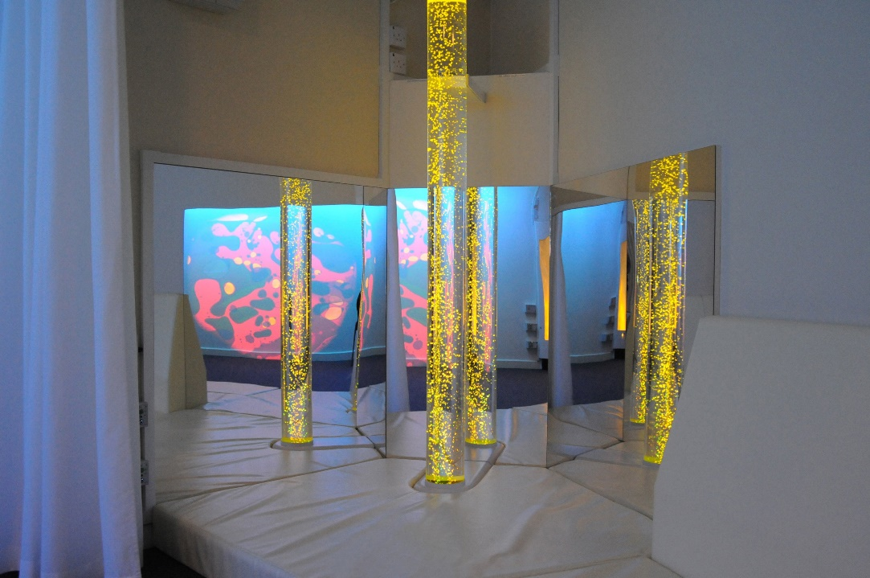
Advantages of a multi-sensory room
A highly controllable sensory environment where specific stimulation activities can be created to meet a learner’s sensory need/skill
Possibilities for creative learning are limited only by the practitioner’s imagination
A quiet focused work space in contrast to a busy classroom
www.multisensorylearning.lgfl.net ©2018 www.hirstwood.com & London Grid for Learning

Slide 3
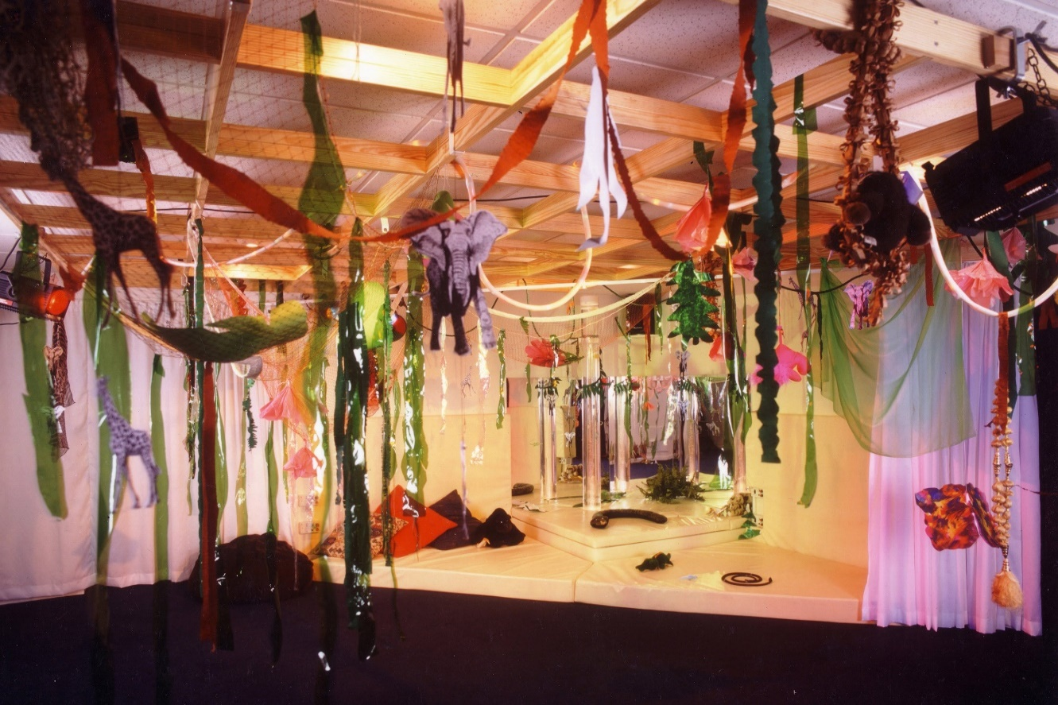
Advantages of a multi-sensory room
Suits individual and group work
Good storage creates a clear distraction free environment
Can be used to deliver curriculum subjects
www.multisensorylearning.lgfl.net ©2018 www.hirstwood.com & London Grid for Learning

Slide 4
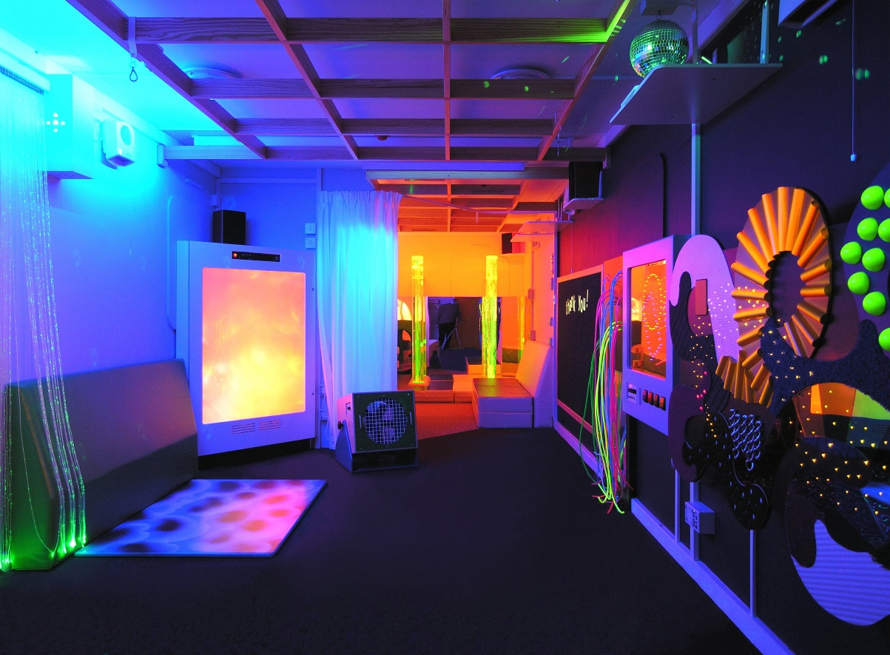
Advantages of a multi-sensory room
An experiential learning environment for all learners, not just those with SEND
Learning in the classroom can be extended in the multi-sensory room and vice versa
www.multisensorylearning.lgfl.net ©2018 www.hirstwood.com & London Grid for Learning

Slide 5
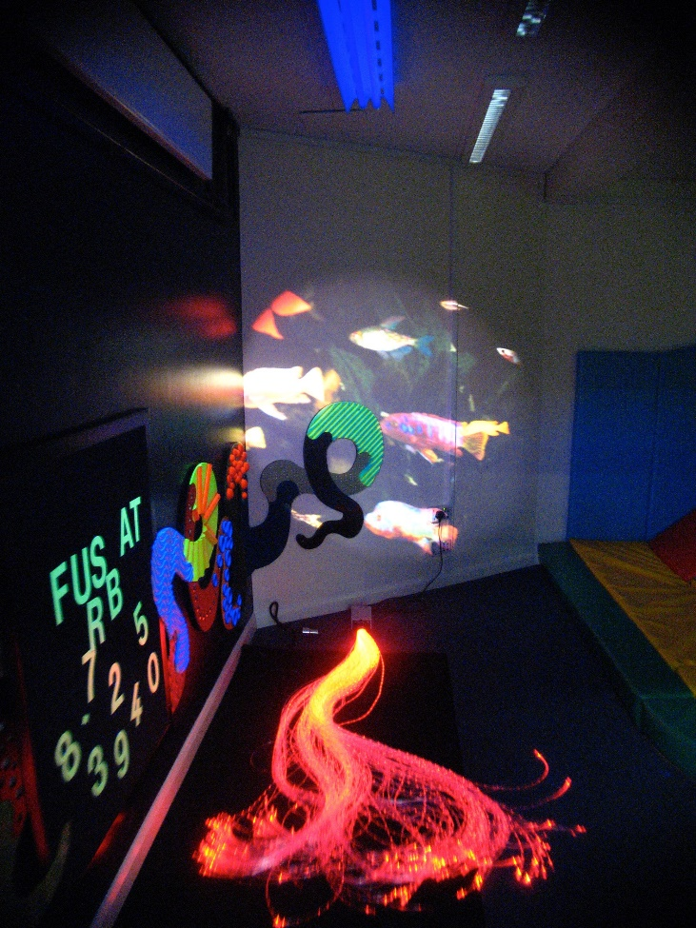
Disadvantages of a multi-sensory room
Often timetabled so it may not be available to use when your learners need it
Expensive to build and maintain
A fixed environment which may be less adaptable to meet learners needs
www.multisensorylearning.lgfl.net ©2018 www.hirstwood.com & London Grid for Learning

Slide 6
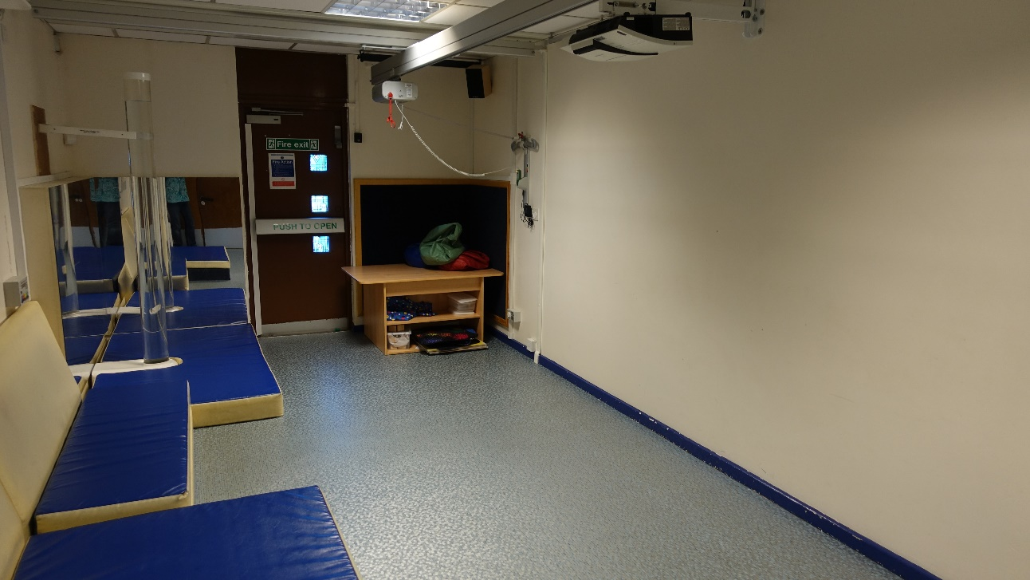
Disadvantages of a multi-sensory room
Training is required to ensure that the equipment is used correctly
Can be used inappropriately becoming a ‘dumping ground’ for learners with no clear learner objectives identified
www.multisensorylearning.lgfl.net ©2018 www.hirstwood.com & London Grid for Learning

Slide 7
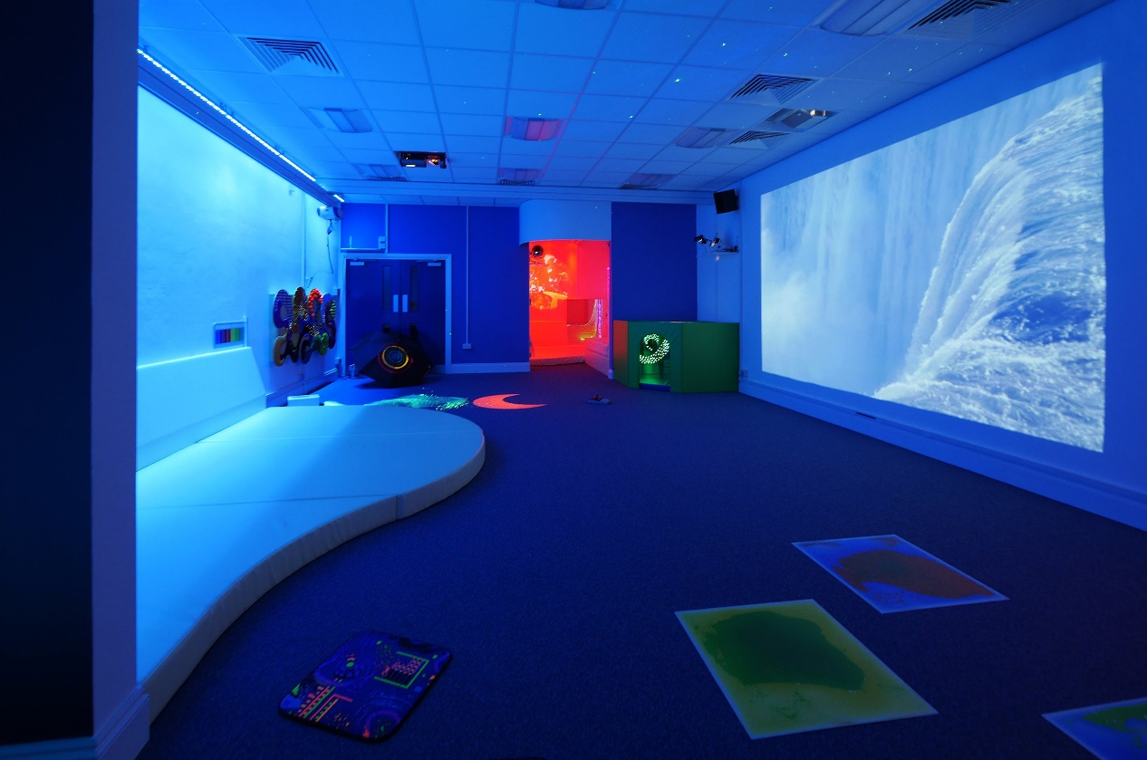
Disadvantages of a multi-sensory room
Misuse of the equipment can result in breakages which are time consuming and expensive to repair
Needs a ‘Multi-Sensory Room Coordinator’ to ensure room is fully functioning at all times
www.multisensorylearning.lgfl.net ©2018 www.hirstwood.com & London Grid for Learning

